Slide 1
An Analysis of the 2018/2019 Fifa World Cups
Billy Hanan
Student No. : 18179797
Postgrad Diploma in Data Analytics
Advanced CRM: CA 2
07/12/2019

Slide 2

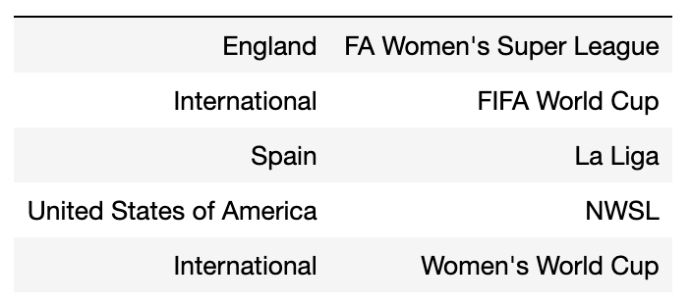

Slide 3
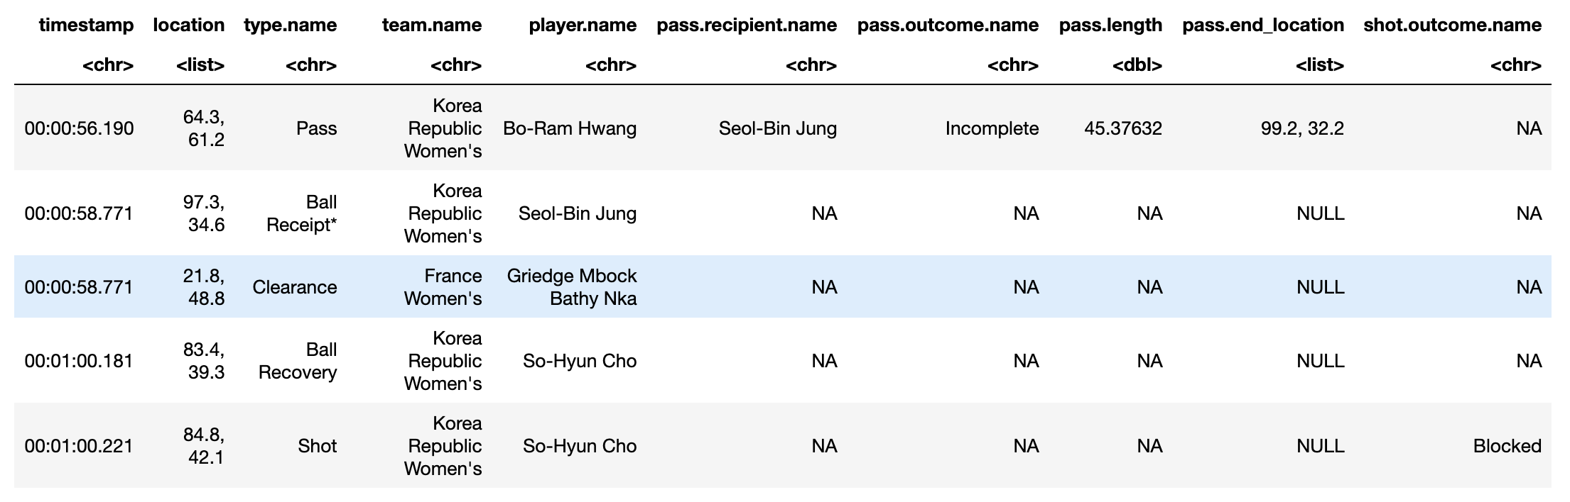
StatsBomb Event Data

Slide 4
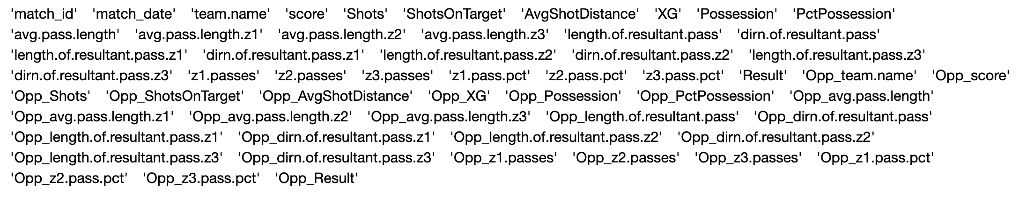
Match Feature Generation

Slide 5
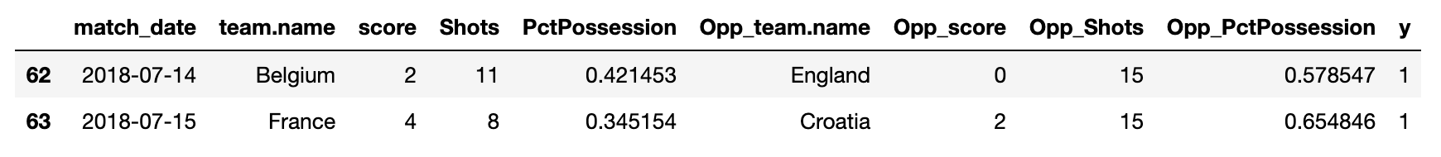
Match Record
DataSets:
World Cup 2018: 64 Match Records
World Cup 2019: 52 Match Records

Slide 6
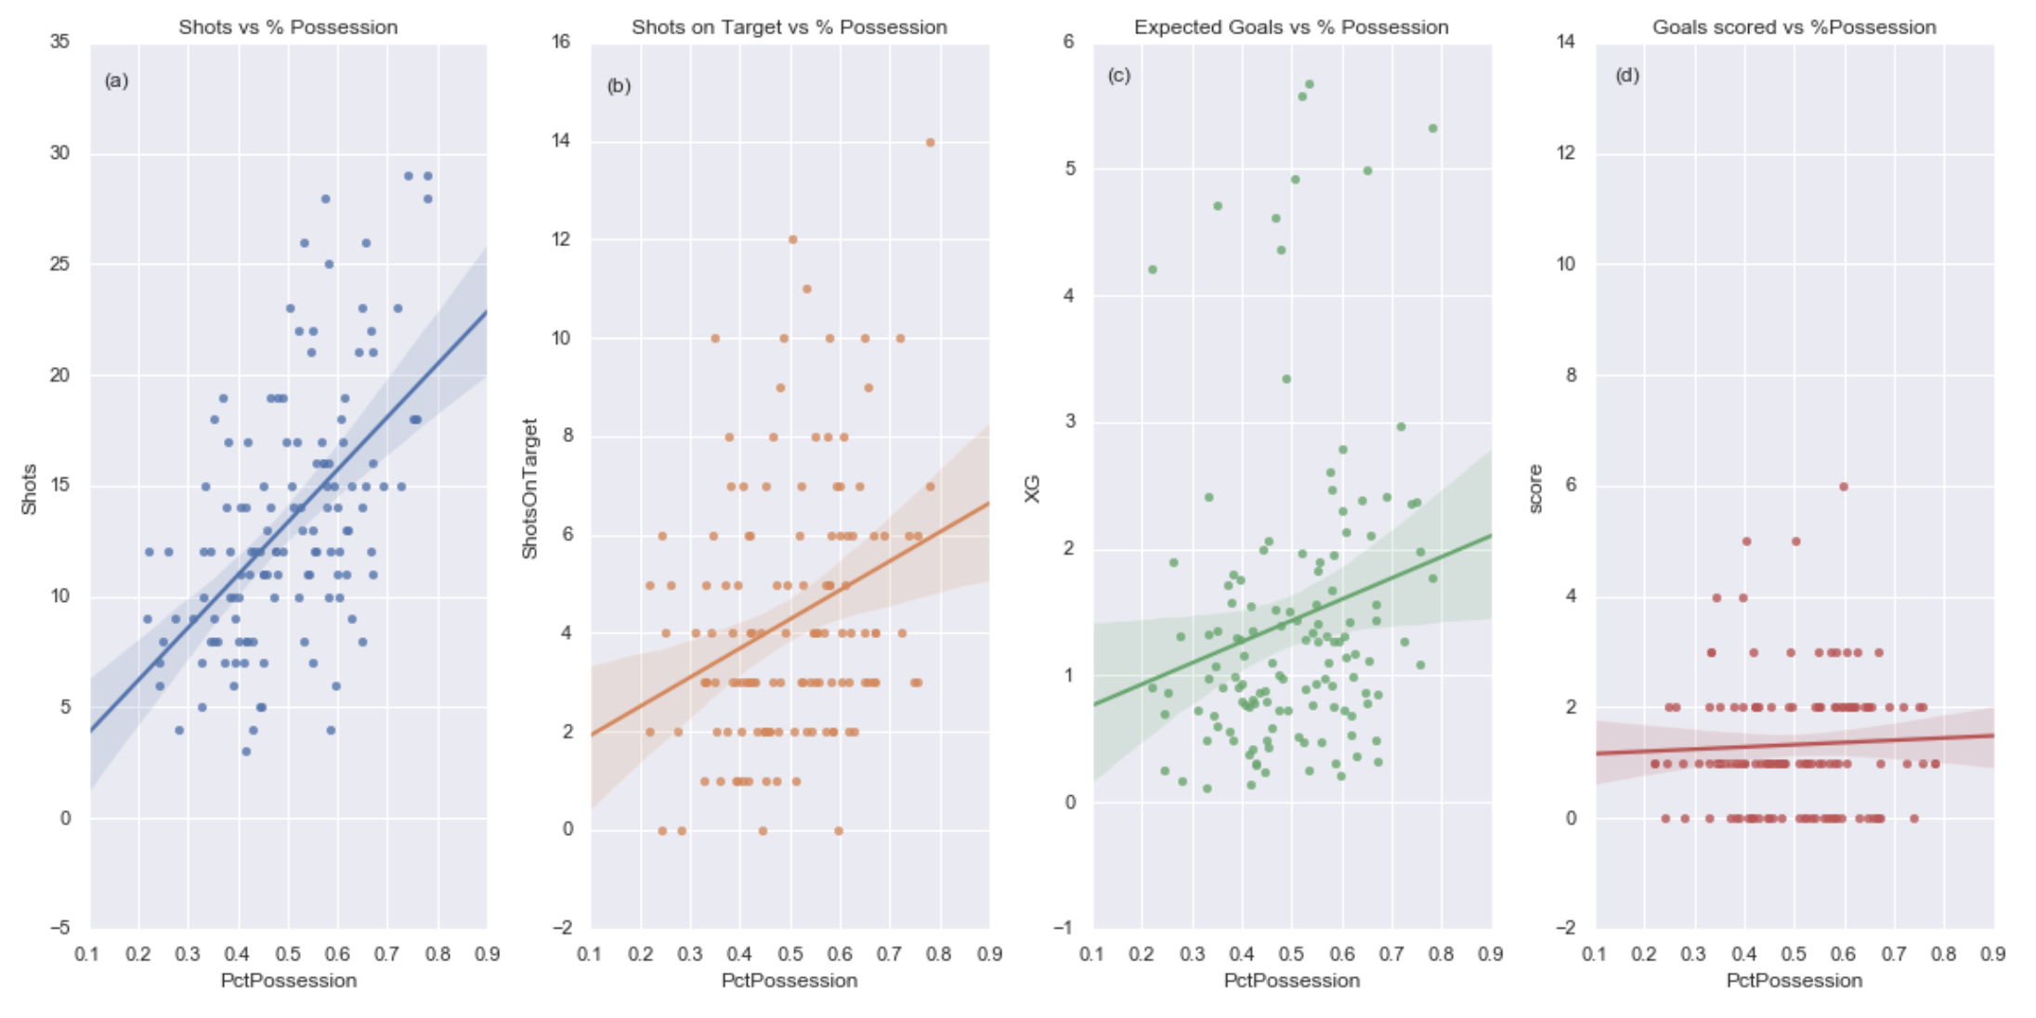
WC 2018: Goals Scored vs Ball Possession
m=23.81 m=5.90 m=1.66 m=0.41
p=1.69e-11 p=0.00091 p=0.03427 p=0.607

Slide 7
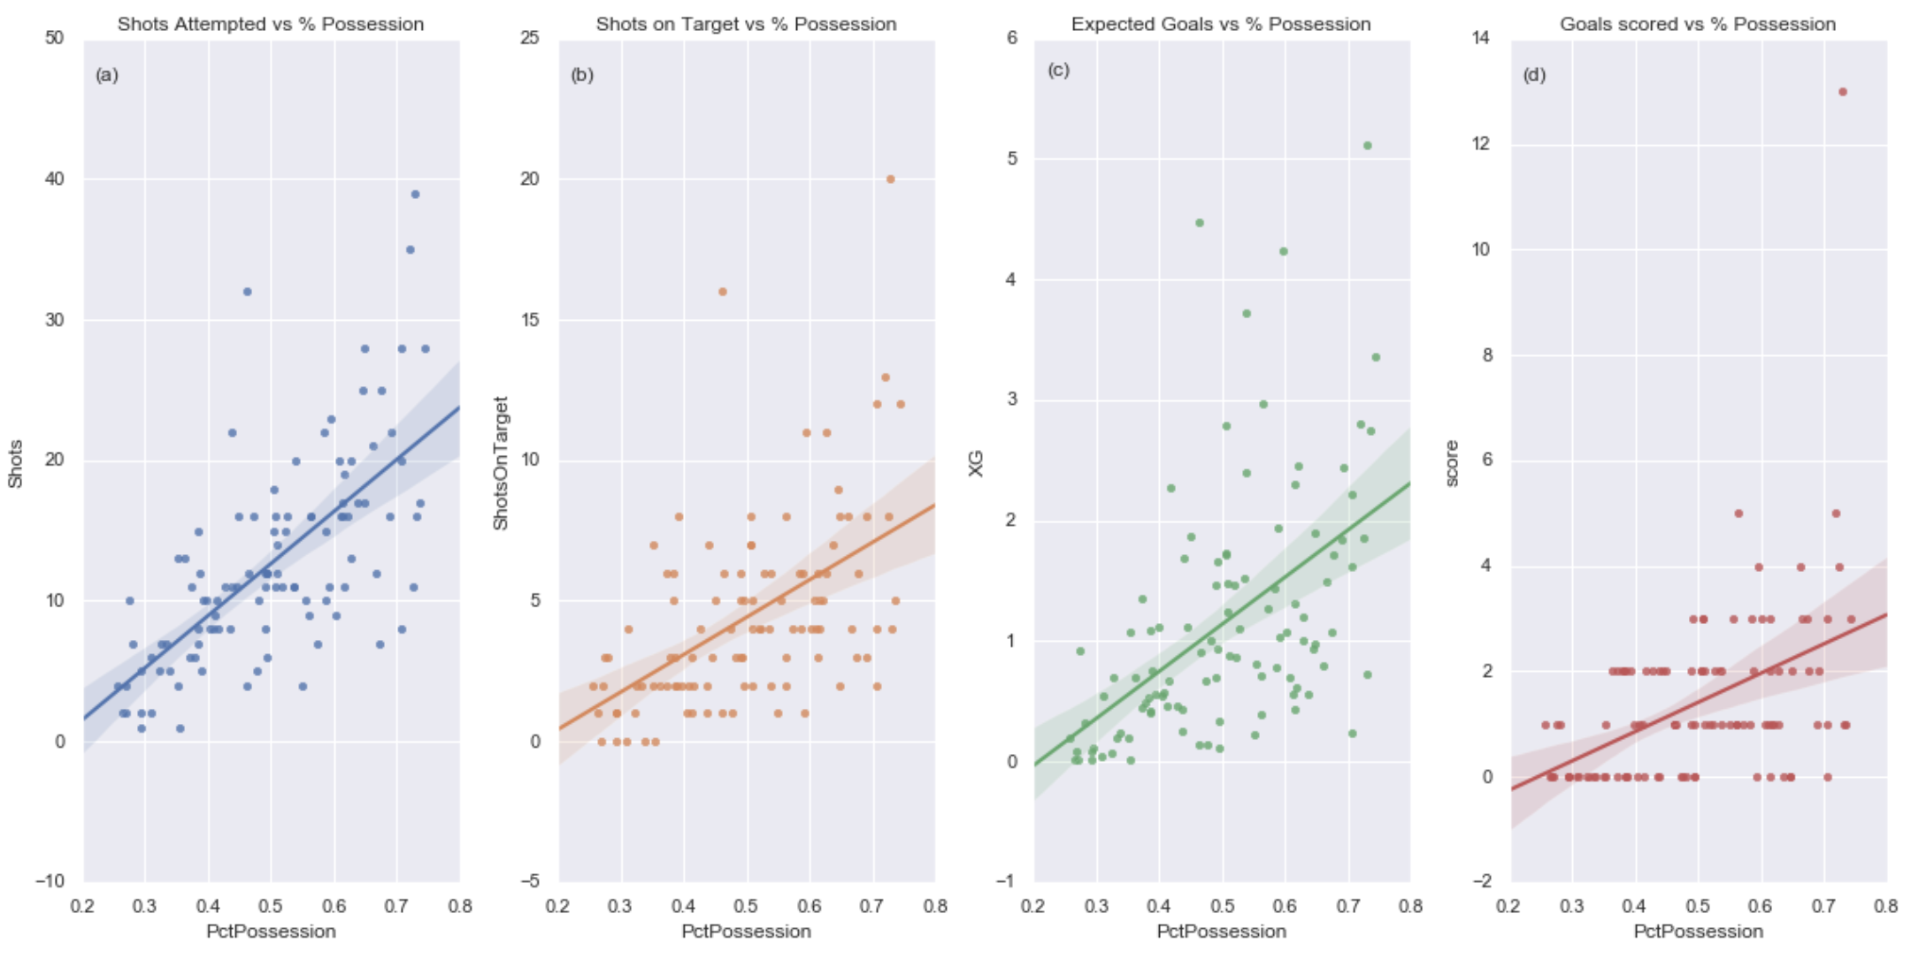
WC 2019: Goals Scored vs Ball Possession
m=37.08 m=13.32 m=3.91 m=4.31
p=4.25e-15 p=1.20e-08 p=1.58e-08 p=4.6e-7

Slide 8
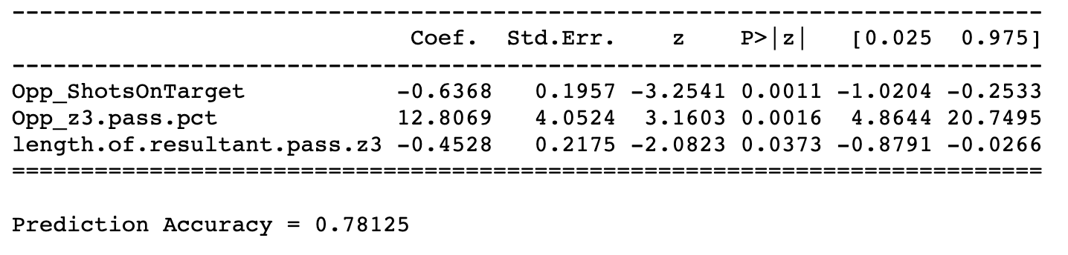
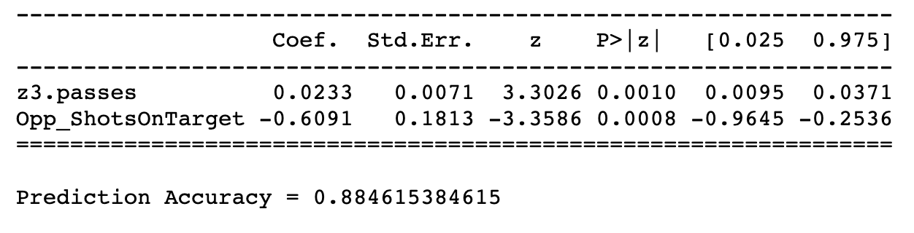
WC 2018 : Logistic Regression Model
WC 2019 : Logistic Regression Model

Slide 9
Conclusion
Ball Possession was an important factor in the women’s World Cup 2019
A tight defence is the single most important characteristic for a winning football team

